Slide 1
第5课
创建和使用数据结构
创建、操作和使用数组、簇及自定义控件对数据进行访问和分析。
数组
常见数组函数
多态性
自动索引
簇
自定义类型

Slide 2
A. 数组
理解应在何时使用数组，学会创建和初始化数组。
一维和二维数组
创建数组控件和常量
初始化数组

Slide 3
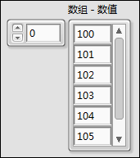
A. 数组
数组
数组将相同类型的数据元素归为一组。
Notes:
Arrays are lists of elements of the same data type. They are analogous to arrays in traditional languages.
Arrays can have one or more dimensions.
Arrays can have up to 2^31 elements per dimension. Actual array sizes that students can create is limited by memory.
Elements are accessed by an index. The index ranges from 0 to N-1 (N = number of elements in the array).
Arrays are zero-indexed (first element is zero) in each dimension.
A 2D array is analogous to a spreadsheet or table.
Example: If your data contains temperature readings and time stamps, one column is time values and the other column is readings.
Be careful to specify the element you really want. Example: The first element in an array is array (0), not array(1).

Slide 4
A. 数组
一维和二维数组示例
一维数组：1行，共10个元素
0 1 2 3 4 5 6 7 8 9
1.2
3.2
8.0
5.1
6.0
1.0
2.5
1.7
索引编号
二维数组：5行7列，共35个元素
0 1 2 3 4 5 6
0
1
2
3
4

Slide 5

A. 数组
二维数组
二维数组特点：
元素按网格方式存储。
需通过行索引和列索引来定位元素，两者均以0为起始编号。

Slide 6
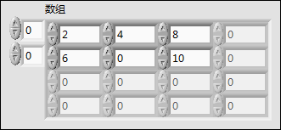
A. 数组
初始化数组
未初始化的数组
初始化的数组

Slide 7

查看数组
索引1对应的第一个元素
索引2对应的第二个元素
索引编号为0的元素未显示，因为索引显示框选择了索引1。
索引显示框中的编号总是对应元素显示框左上角的元素。

Slide 8
B. 常见数组函数
使用内置数组函数创建数组并对其进行操作。

Slide 9
常见数组函数
使用LabVIEW内置数组函数创建数组并对其进行操作。

Slide 10
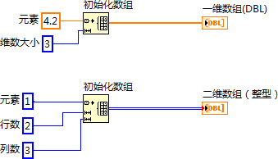

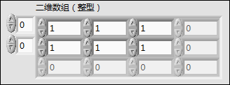
B. 常见数组函数
初始化数组
Notes:
The Initialize Array function creates an n-dimensional array in which every element is initialized to the value of element.
Initialize array is a resizable node. Use the Positioning tool to resize the function and increase the number of dimensions (element, row, column, page, and so on) of the output array. You must have one dimension size input terminal for each dimension in the array.

Slide 11
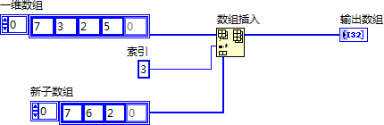

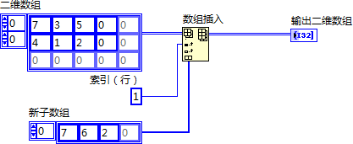
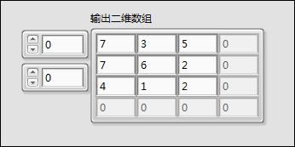
B. 常见数组函数
数组插入

Slide 12
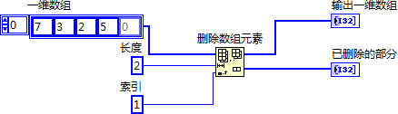
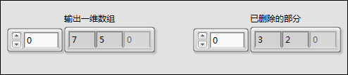
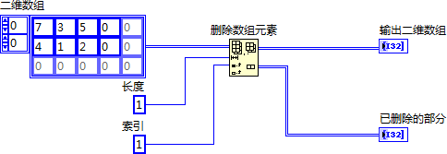
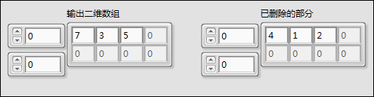
B. 常见数组函数
删除数组元素

Slide 13
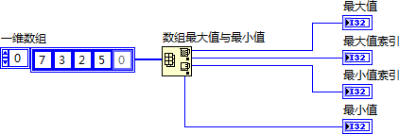
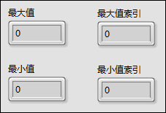
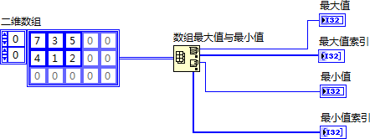
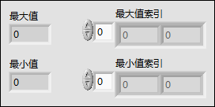
B. 常见数组函数
数组最大值与最小值

Slide 14
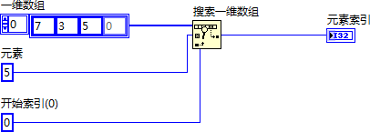

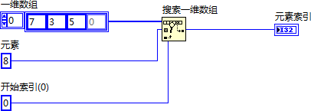

B. 常见数组函数
搜索一维数组

Slide 15
活动5-1
使用数组函数
完成各VI中的高亮部分。

Slide 16
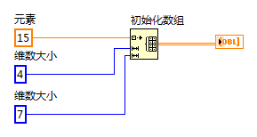
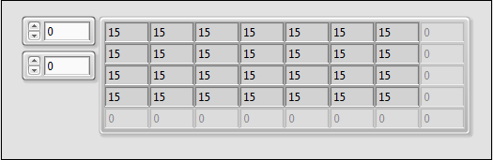
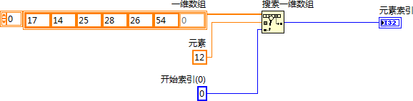
B. 常见数组函数
活动5-1答案

Slide 17
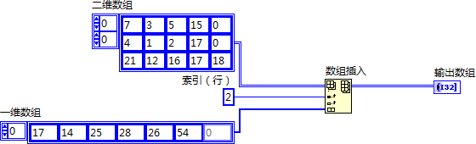
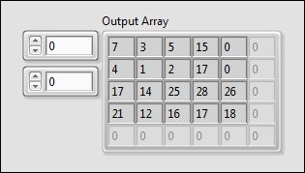
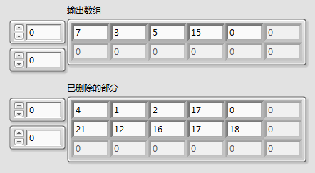
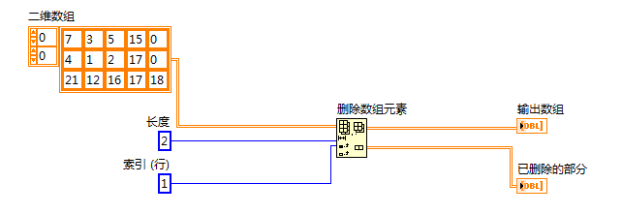
B. 常见数组函数
活动5-1答案

Slide 18
C. 多态性
理解部分VI可接受不同数据类型输入的能力。

Slide 19

C. 多态性
多态性
多态性－VI和函数能够自动适应不同类型的输入数据。
函数多态性的程度各不相同：
可以是允许全部或部分多态输入，也可以完全不允许多态输入。
有的函数可接收数值或布尔值。
有的函数可接收数值或字符串。
有的函数还可接收数值标量、数值数组或数值簇。
Notes:
Functions are polymorphic to varying degrees—none, some, or all of their inputs can be polymorphic. Some function inputs accept numeric values or Boolean values. Some accept numeric values or strings. Some accept not only scalar numeric values but also arrays of numeric values, clusters of numeric values, arrays of clusters of numeric values, and so on. Some accept only one-dimensional arrays although the array elements can be of any type. Some functions accept all types of data, including complex numeric values.

Slide 20
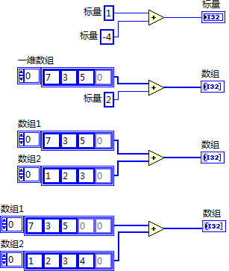




C. 多态性
算术函数为多态函数
组合
结果
Notes:
LabVIEW arithmetic functions are polymorphic.
Inputs to arithmetic functions can be of different data types.
The function automatically performs the appropriate operation on unlike data types.
LabVIEW arithmetic functions greatly simplify array arithmetic.
Examples of polymorphism on this slide:
Scalar+Scalar: Scalar addition.
Scalar+Array: The scalar is added to each element of array.
Array+Array: Each element of one array is added to the corresponding element of other array.
In case students ask, polymorphism does not perform matrix arithmetic when inputs are 2D arrays. (For example, multiplying two 2D array inputs with the Multiply function performs an element by element multiplication, not matrix multiplication).
LabVIEW ships with other examples of arithmetic functions showing polymorphic combinations of inputs.

Slide 21
D. 自动索引
使用自动索引的输入和输出创建图形和数组。
用于For循环和While循环
波形图
带有条件接线端的自动索引
创建二维数组
循环结构的自动索引输入

Slide 22


D. 自动索引
自动索引
启用自动索引
禁用自动索引
连线变粗
连线粗细不变
一维数组
仅一个值通过循环传出（最后一次循环产生的值）。
0 1 2 3 4 5
Notes:
For Loops and While Loops can index and accumulate arrays at their boundaries. This is known as auto-indexing.
The indexing point on the boundary is called a tunnel.
The For Loop default is auto-indexing enabled.
The While Loop default is auto-indexing disabled. Only one value (the last iteration) is passed out of the While Loop by default.
Examples:
Enable auto-indexing to collect values within the loop and build the array. All values are placed in the array upon exiting the loop.
Disable auto-indexing if you are interested only in the final value.

Slide 23
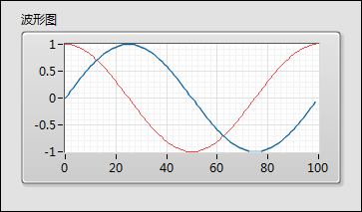
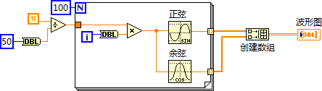
D. 自动索引
波形图

Slide 24
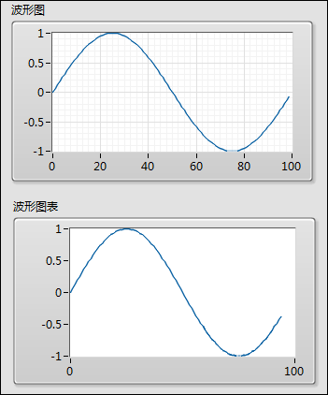
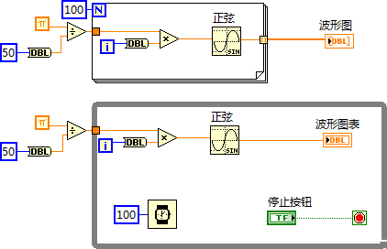
D. 自动索引
图表 vs. 图形－单曲线

Slide 25
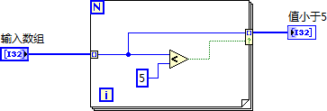


D. 自动索引
带有条件隧道的自动索引
右键单击隧道，选择隧道模式»条件。
Notes:
You can determine what values LabVIEW writes to the loop output tunnel based on a condition you specify by right-clicking the loop output tunnel and selecting Tunnel Mode»Conditional from the shortcut menu.
Because of the conditional tunnel, the Values less than 5 array contains only the elements 2, 0, 3, and 1 after this loop completes all iterations.

Slide 26
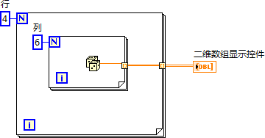
D. 自动索引
创建二维数组
里层的循环创建列元素。
外层的循环将列元素堆栈为行。
二维数组
一维数组
0 1 2 3 4 5
Notes:
You can use two nested For Loops to create a 2D array. Auto-indexing must be enabled for both loops.
Explain the different line thicknesses in the wire connecting the Random Number function to the 2D Array Indicator.
Demonstrate on your computer:
How to change indexing and line thickness.
When you see Enable indexing in the shortcut menu it means that indexing is currently disabled. The menu choice is the opposite of the current indexing mode. Students get confused about this feature.

Slide 27
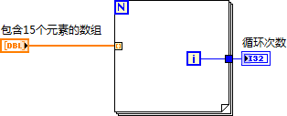
D. 自动索引
自动索引输入
使用自动索引输入数组对数组中的每个元素执行计算。
连线数组至For循环的自动索引隧道。
无需连线总数(N)接线端。
Notes:
If you enable auto-indexing on an array wired to a For Loop input terminal, LabVIEW sets the count terminal to the array size so you do not need to wire the count terminal. Normally, if the count terminal of the For Loop is not wired, the Run arrow is broken.
In this slide, the For Loop executes a number of times equal to the number of elements in the array.
Use auto-indexing on input arrays for calculations to be performed on each element of array.
To pass the entire array into a loop, disable auto-indexing.

Slide 28
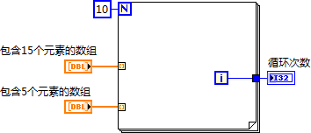

D. 自动索引
自动索引输入─数组大小不同
Notes:
LabVIEW does not exceed an array size. This helps to protect against programming errors.
If you wire a 10-element array and a 5-element array to a For loop, the loop iterates five times.
Note: Although the For loop iterates 5 times, the number of iterations is zero-based. Therefore, the final value of the Iterations indicator is 4.

Slide 29
练习5-1
对数组进行操作
使用不同的LabVIEW函数对数组进行操作。

Slide 30
练习5-1
对数组进行操作
在“全部数据通道”条件分支中，如何验证两种方法获得的结果相同？
Notes:
In the All Data Channel case, how can we verify that the two approaches yield the same results?
You can use the comparison and Boolean functions to compare if the All Data Channel array is the same.
Comparison functions are also polymorphic. Use the Equal? function followed by the And Array Elements function.
Typically, you can’t perform a direct comparison on double-precision values. You would need to compare the values within some acceptable range. However, in this case, the polymorphic Add operation should be an exact equivalent to the Add function in an auto-indexed For loop.

Slide 31
E. 簇
理解应在何时使用簇并学会创建簇。
使用簇的原因
簇 vs. 数组
创建簇控件和常量
对项进行排序并调整簇大小
分解簇和改变簇
绘制数据图表

Slide 32
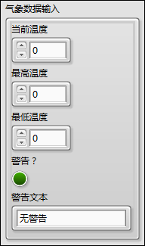
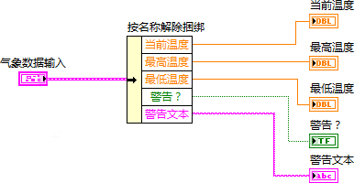
E. 簇
簇
簇将不同类型的数据元素归为一组。
簇类似于文本编程语言中的结构体。
Notes:
Additional items to mention:
Bundling several data elements into clusters eliminates wire clutter on the block diagram and reduces inputs and outputs for subVIs.
Most clusters on the block diagram have a pink wire and data type terminal.
Clusters of numeric values, sometimes referred to as points, have a brown wire and data type terminal.
You can wire brown numeric clusters to Numeric functions to perform the same operation simultaneously on all elements of the cluster.

Slide 33
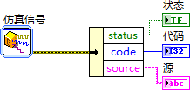
E. 簇
簇 vs. 数组
簇
混合数据类型
大小固定
数组
单一数据类型
大小不固定

Slide 34

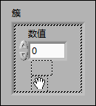
创建簇控件
.

Slide 35
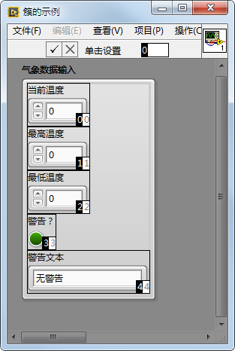
E. 簇
簇顺序
簇元素的逻辑顺序与元素在簇外框中的位置无关。

Slide 36
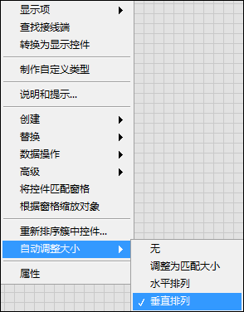
E. 簇
自动调整簇大小
排列簇中的元素
排列建议：
垂直排列
紧凑排列
按元素首选顺序排列

Slide 37

E. 簇
分解簇
按名称解除捆绑
如元素全部命名，使用该函数。
解除捆绑
如存在未命名元素，使用该函数。
loc_bd_cluster_unbundle

Slide 38


E. 簇
更改簇
按名称捆绑
访问簇中元素
捆绑
如存在未命名元素，使用该函数。
输入簇接线端必须始终连线。

Slide 39

在程序框图上创建一个簇

Slide 40
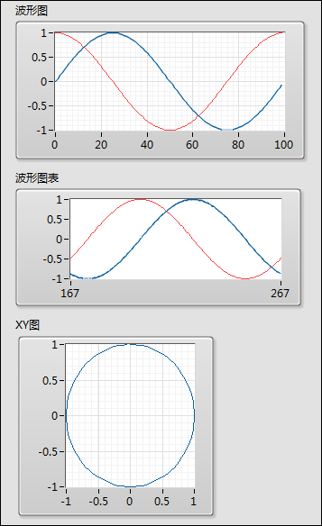
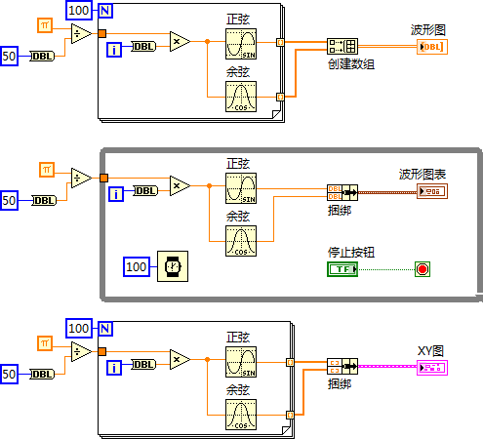
E. 簇
多曲线图形/图表和XY图
Notes:
The Bundle function is often used to create multi-chart plot charts and XY plots.
The Build Array function is used to create multi-plot waveform graphs.

Slide 41
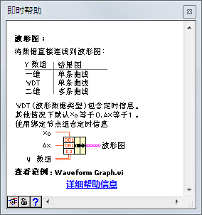
E. 簇
绘制数据图表
通过即时帮助窗口了解连接多曲线数据至图形、图表和XY图的方法。
Notes:
Use the Context Help and shipping examples to investigate all the possible ways to assemble data for various graphical displays.
LabVIEW examples and help provide extensive information on wiring data to the various graphical displays.

Slide 42
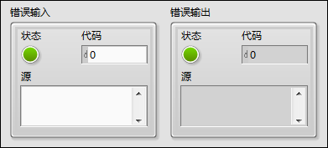
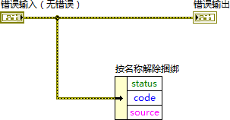
E. 簇
错误簇
错误簇包含下列元素：
状态
代码
源

Slide 43
练习5-2
“温度警告”VI─簇
创建簇、重新排列簇中元素并使用簇函数组合和分解簇。

Slide 44
练习5-2
“温度警告”VI─簇
重新排列簇中元素，将发生什么情况？
如果添加一个簇元素至“气象数据输出”，将发生什么情况？
Notes:
What would happen if you reordered cluster elements?
Both the subVI and calling VI would continue to work as expected since the only cluster functions used are Unbundle By Name and Bundle By Name. A change to element order in a cluster does not break these functions.
What would happen if you added a cluster element to Weather Data Out?
Both the subVI and the calling VI would be broken because of mismatching cluster data types.

Slide 45
F. 自定义类型
认识自定义类型、严格自定义类型和控件的区别，理解其使用场景。

Slide 46
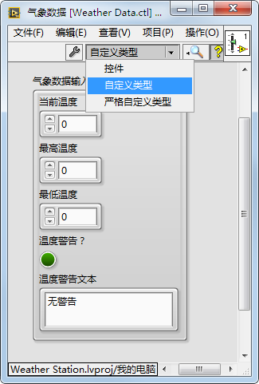
F. 自定义类型
控件选项
自定义控件可保存为下列类型：
控件
自定义类型
严格自定义类型
Notes:
LabVIEW has three kinds of custom controls (.ctl files):
A regular custom control
Used to create controls that behave like existing controls but look different.
A type def or type definition control
Used for changing all instances of a linked control in a single edit.
A strict type def control
Used for changing instances in a single edit.
Used to ensure all instances have same appearance.

Slide 47
控件、自定义类型和严格自定义类型的区别

Slide 48
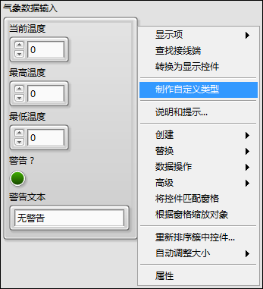

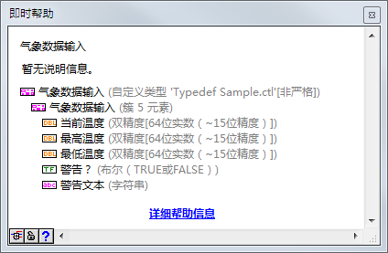
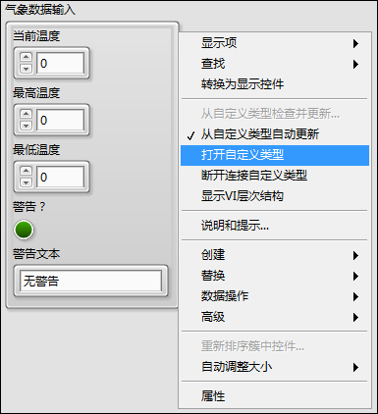
创建和定义自定义类型

Slide 49
练习5-3
“温度警告”VI─自定义类型
创建并修改一个自定义类型簇控件，并在调用方VI和子VI中使用该自定义类型。
Notes:
This exercise explores the differences between a type definition and a strict type definition.

Slide 50
练习5-3
“温度警告”VI─自定义类型
当前“气象数据”控件被保存为自定义类型，如要添加风速数据，需要更新几个簇的实例？
Notes:
Now that the Weather Data control is saved as a type definition, how many instances of the cluster would need to be updated to add wind speed data?
One. You add elements to the type definition. Apply and save changes.
Converting from a cluster to a type definition requires a one-time update to each cluster. However, once you have your data in a type definition, adding or removing elements is a simple update to the type definition control.

Slide 51

活动5-2
课程回顾
参考学员指南回答本课所学内容的相关问题，并分组进行讨论。

Slide 52
课程回顾
可以创建由数组组成的数组。
对
错
Notes:
Answer is False.

Slide 53
课程回顾
可以创建由数组组成的数组。
对
错
不能拖曳数组数据类型至数组外框，但可创建二维数组。

Slide 54
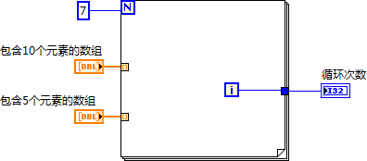
课程回顾
VI运行结束后，循环次数显示控件的值是多少？
Notes:
Answer is 4.

Slide 55
课程回顾
VI运行结束后，循环次数显示控件的值是多少？
4
Notes:
LabVIEW does not exceed the array size. This helps to protect against programming error. So the loop runs 5 times.
Although the for loop runs 5 times, the iterations are zero-based. Therefore the value of the Iterations indicators is 4.

Slide 56
课程回顾
下列哪个自定义控件设置定义了控件全部实例的数据类型，但允许不同的颜色和字体样式？
控件
自定义类型
严格自定义类型
簇控件
Notes:
Answer is b.

Slide 57
课程回顾
下列哪个自定义控件设置定义了控件全部实例的数据类型，但允许不同的颜色和字体样式？
控件
自定义类型
严格自定义类型
簇控件
Notes:
A standard type definition ensures that all instances of the control use the same data type but allows for flexibility in colors and font styles. A strict type definition is similar to a type definition but forces everything to be identical except label, description and default value. There is no connection between a custom control and the instance of a custom control. Therefore selecting control does not define the data type of all instances.

Slide 58
课程回顾
设有代表圆的输入数据：X坐标(I16)、Y坐标(I16)和半径(I16)。未来可能需要更改这些数据以加入圆的颜色(U32)。 请问应在应用程序中使用何种数据结构表示该圆？
使用3个独立控件分别表示坐标和半径值
使用簇，簇中包含所有数据元素
使用包含簇的自定义控件
使用包含簇的自定义类型控件
使用包含3个元素的数组
(X,Y)
R
Notes:
Answer is d.

Slide 59
课程回顾
设有代表圆的输入数据：X坐标(I16)、Y坐标(I16)和半径(I16)。未来可能需要更改这些数据以加入圆的颜色(U32)。 请问应在应用程序中使用何种数据结构表示该圆？
使用3个独立控件分别表示坐标和半径值
使用簇，簇中包含所有数据元素
使用包含簇的自定义控件
使用包含簇的自定义类型控件
使用包含3个元素的数组
(X,Y)
R
Notes:
Answer is d.

